Slide 1

SENSORS Interfacing to the Real World: Review of Electrical Sensors and Actuators
Dr. Md. Sazzadur Rahman
Associate Professor
Jahangirnagar University

Slide 2
Transducers
Transducer
a device that converts a primary form of energy into a corresponding signal with a different energy form
Primary Energy Forms: mechanical, thermal, electromagnetic, optical, chemical, etc.
take form of a sensor or an actuator
Sensor (e.g., thermometer)
a device that detects/measures a signal or stimulus
acquires information from the “real world”
Actuator (e.g., heater)
a device that generates a signal or stimulus
real
world
sensor
intelligent
feedback
system
actuator

Slide 3
Sensor Systems
Typically interested in electronic sensor
convert desired parameter into electrically measurable signal
General Electronic Sensor
primary transducer: changes “real world” parameter into electrical signal
secondary transducer: converts electrical signal into analog or digital values
Typical Electronic Sensor System
real
world
analog
signal
usable
values
primary
transducer
secondary
transducer
sensor
input
signal
(measurand)
microcontroller
signal processing
communication
sensor
sensor data
analog/digital
network
display

Slide 4
Example Electronic Sensor Systems
Components vary with application
digital sensor within an instrument
microcontroller
signal timing
data storage
analog sensor analyzed by a PC
multiple sensors displayed over internet
sensor
µC
signal timing
memory
keypad
sensor
display
handheld instrument
sensor interface
A/D, communication
signal processing
e.g., RS232
PC
sensor
comm. card
internet
sensor
sensor bus
PC
sensor bus
sensor
processor
processor
comm.
comm.
comm. card

Slide 5
Primary Transducers
Conventional Transducers
large, but generally reliable, based on older technology
thermocouple: temperature difference
compass (magnetic): direction
Microelectronic Sensors
millimeter sized, highly sensitive, less robust
photodiode/phototransistor: photon energy (light)
infrared detectors, proximity/intrusion alarms
piezoresisitve pressure sensor: air/fluid pressure
microaccelerometers: vibration, ∆-velocity (car crash)
chemical senors: O₂, CO₂, Cl, Nitrates (explosives)
DNA arrays: match DNA sequences

Slide 6
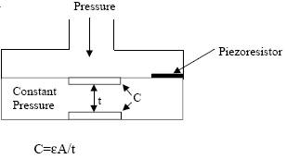
Example Primary Transducers
Light Sensor
photoconductor
light → ΔR
photodiode
light → ΔI
membrane pressure sensor
resistive (pressure → Δ R)
capacitive (pressure → ΔC)

Slide 7
Displacement Measurements
Measurements of size, shape, and position utilize displacement sensors
Examples
diameter of part under stress (direct)
movement of a microphone diaphragm to quantify liquid movement through the heart (indirect)
Primary Transducer Types
Resistive Sensors (Potentiometers & Strain Gages)
Inductive Sensors
Capacitive Sensors
Piezoelectric Sensors
Secondary Transducers
Wheatstone Bridge
Amplifiers

Slide 8
Strain Gage: Gage Factor
Remember: for a strained thin wire
ΔR/R = ΔL/L – ΔA/A + Δρ/ρ
A = π (D/2)², for circular wire
Poisson’s ratio, μ: relates change in diameter D to change in length L
ΔD/D = - μ ΔL/L
Thus
ΔR/R = (1+2μ) ΔL/L + Δρ/ρ
Gage Factor, G, used to compare strain-gage materials
G = ΔR/R = (1+2μ) + Δρ/ρ
ΔL/L ΔL/L
D
L
dimensional effect
piezoresistive effect

Slide 9
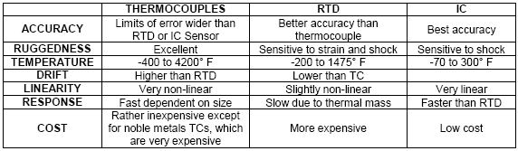
Temperature Sensor Options
Resistance Temperature Detectors (RTDs)
Platinum, Nickel, Copper metals are typically used
positive temperature coefficients
Thermistors (“thermally sensitive resistor”)
formed from semiconductor materials, not metals
often composite of a ceramic and a metallic oxide (Mn, Co, Cu or Fe)
typically have negative temperature coefficients
Thermocouples
based on the Seebeck effect: dissimilar metals at diff. temps. → signal

Slide 10
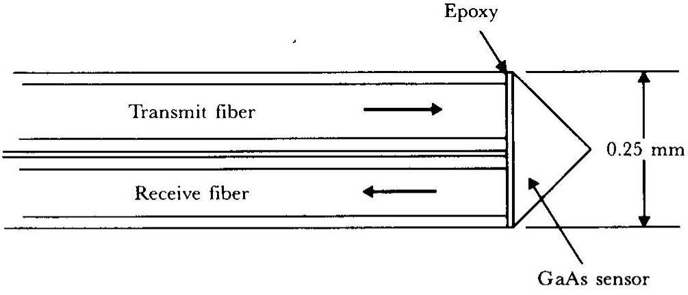
Fiber-optic Temperature Sensor
Sensor operation
small prism-shaped sample of single-crystal undoped GaAs attached to ends of two optical fibers
light energy absorbed by the GaAs crystal depends on temperature
percentage of received vs. transmitted energy is a function of temperature
Can be made small enough for biological implantation
GaAs semiconductor temperature probe

Slide 11
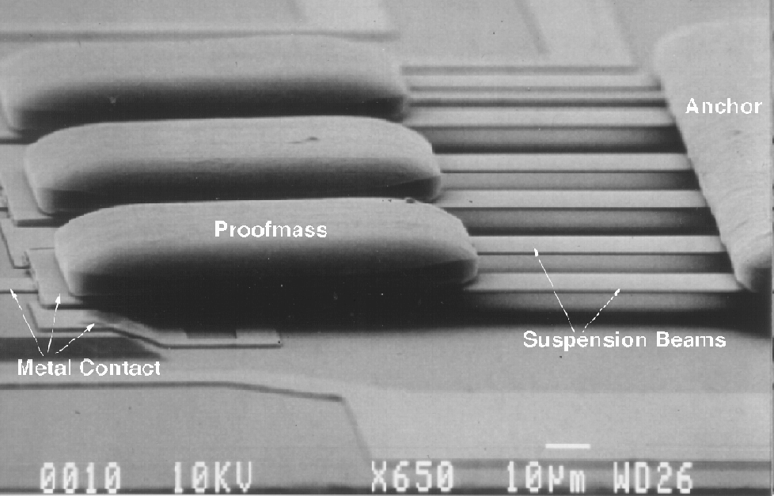
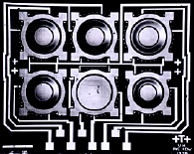
Example MEMS Transducers
MEMS = micro-electro-mechanical system
miniature transducers created using IC fabrication processes
Microaccelerometer
cantilever beam
suspended mass
Rotation
gyroscope
Pressure
Diaphragm (Upper electrode)
Lower electrode
5-10mm

Slide 12
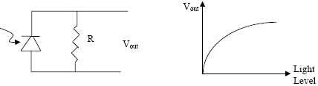
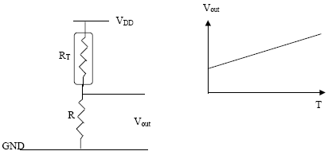
Passive Sensor Readout Circuit
Photodiode Circuits
Thermistor Half-Bridge
voltage divider
one element varies
Wheatstone Bridge
R3 = resistive sensor
R4 is matched to nominal value of R3
If R₁ = R₂, V_{out-nominal} = 0
V_{out} varies as R₃ changes
VCC
R1+R4

Slide 13
Operational Amplifiers
Properties
open-loop gain: ideally infinite: practical values 20k-200k
high open-loop gain → virtual short between + and - inputs
input impedance: ideally infinite: CMOS opamps are close to ideal
output impedance: ideally zero: practical values 20-100Ω
zero output offset: ideally zero: practical value <1mV
gain-bandwidth product (GB): practical values ~MHz
frequency where open-loop gain drops to 1 V/V
Commercial opamps provide many different properties
low noise
low input current
low power
high bandwidth
low/high supply voltage
special purpose: comparator, instrumentation amplifier

Slide 14
Basic Opamp Configuration
Voltage Comparator
digitize input
Voltage Follower
buffer
Non-Inverting Amp
Inverting Amp

Slide 15
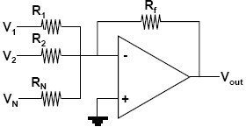
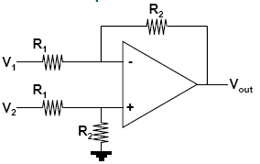
More Opamp Configurations
Summing Amp
Differential Amp
Integrating Amp
Differentiating Amp

Slide 16
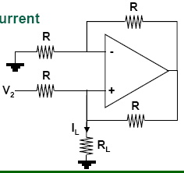
Converting Configuration
Current-to-Voltage
Voltage-to-Current

Slide 17
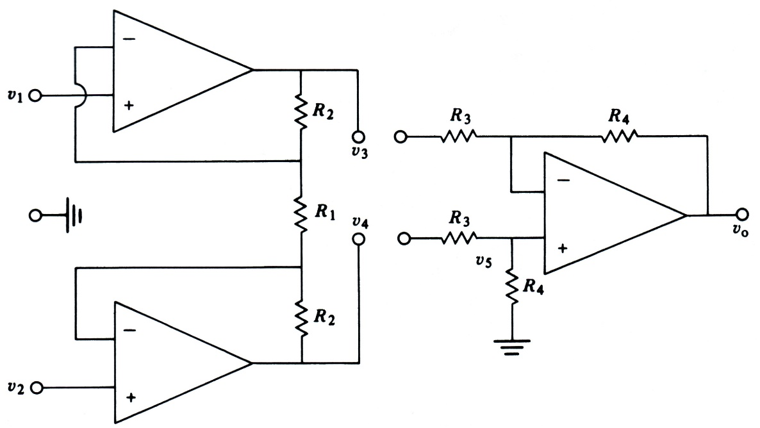
Instrumentation Amplifier
Robust differential
gain amplifier
Input stage
high input impedance
buffers gain stage
no common mode gain
can have differential gain
Gain stage
differential gain, low input impedance
Overall amplifier
amplifies only the differential component
high common mode rejection ratio
high input impedance suitable for biopotential electrodes with high output impedance
gain stage
input stage
total differential gain

Slide 18
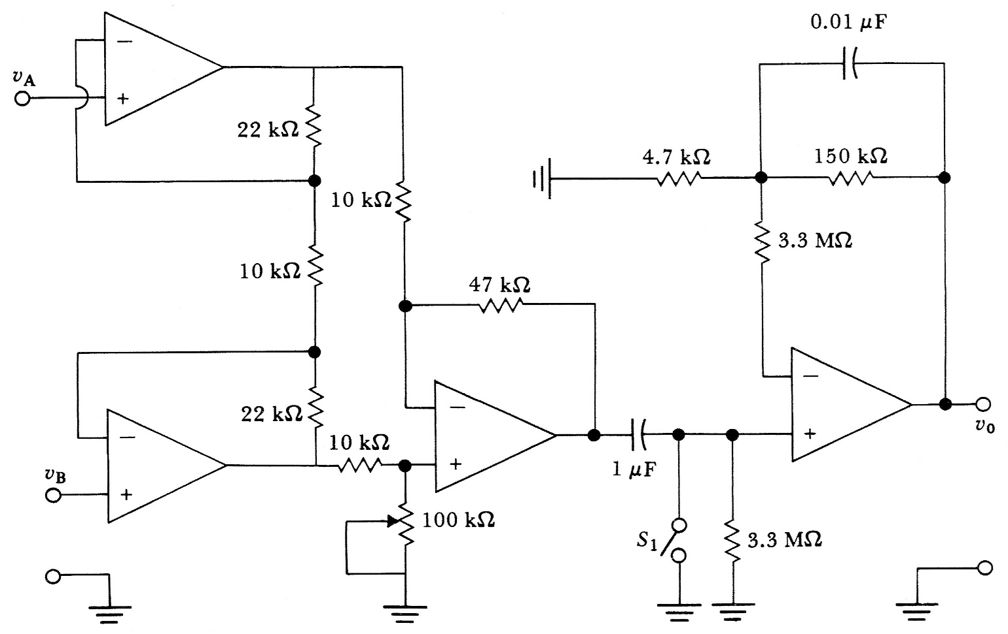
Instrumentation Amplifier w/ BP Filter
instrumentation amplifier
HPF
non-inverting amp
With 776 op amps, the circuit was found to have a CMRR of 86 dB at 100 Hz and a noise level of 40 mV peak to peak at the output. The frequency response was 0.04 to 150 Hz for ±3 dB and was flat over 4 to 40 Hz. The total gain is 25 (instrument amp) x 32 (non-inverting amp) = 800.

Slide 19
Connecting Sensors to Microcontrollers
Analog
many microcontrollers have a built-in A/D
8-bit to 12-bit common
many have multi-channel A/D inputs
Digital
serial I/O
use serial I/O port, store in memory to analyze
synchronous (with clock)
must match byte format, stop/start bits, parity check, etc.
asynchronous (no clock): more common for comm. than data
must match baud rate and bit width, transmission protocol, etc.
frequency encoded
use timing port, measure pulse width or pulse frequency
sensor
µC
signal timing
memory
keypad
sensor
display
instrument

Slide 20
Connecting Smart Sensors to PC/Network
“Smart sensor” = sensor with built-in signal processing & communication
e.g., combining a “dumb sensor” and a microcontroller
Data Acquisition Cards (DAQ)
PC card with analog and digital I/O
interface through LabVIEW or user-generated code
Communication Links Common for Sensors
asynchronous serial comm.
universal asynchronous receive and transmit (UART)
1 receive line + 1 transmit line. nodes must match baud rate & protocol
RS232 Serial Port on PCs uses UART format (but at +/- 12V)
can buy a chip to convert from UART to RS232
synchronous serial comm.
serial peripheral interface (SPI)
1 clock + 1 bidirectional data + 1 chip select/enable
I²C = Inter Integrated Circuit bus
designed by Philips for comm. inside TVs, used in several commercial sensor systems
IEEE P1451: Sensor Comm. Standard
several different sensor comm. protocols for different applications

Slide 21
Sensor Calibration
Sensors can exhibit non-ideal effects
offset: nominal output ≠ nominal parameter value
nonlinearity: output not linear with parameter changes
cross parameter sensitivity: secondary output variation with, e.g., temperature
Calibration = adjusting output to match parameter
analog signal conditioning
look-up table
digital calibration
T = a + bV +cV²,
T= temperature; V=sensor voltage;
a,b,c = calibration coefficients
Compensation
remove secondary sensitivities
must have sensitivities characterized
can remove with polynomial evaluation
P = a + bV + cT + dVT + e V², where P=pressure, T=temperature
linear
T1
non-linear
T2
offset
T3

